Slide 1
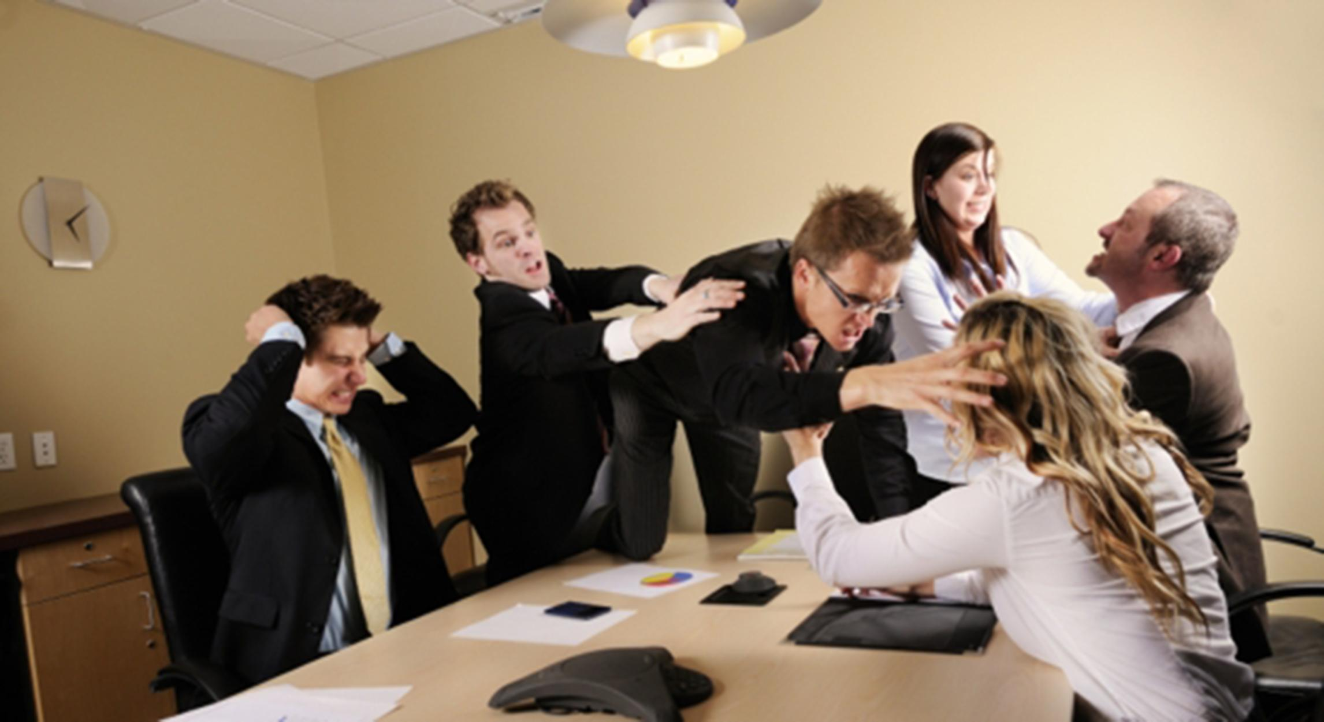
Forming Teams for the Course

Slide 2
An important part of this course is learning to work as a team on a common project.
30% of your grade will be determined by your team score. (1 grade per student)
15% is class attendance (1 grade per student)
Average of homework scores (1 grade per team) is 35% of grade
Grade on final team project and presentation is 20% of grade (1 grade per team).
Note that each week’s homework and final project all will require classroom (Zoom) presentations.

Slide 3

In the real world, you do have to present your ideas and status. It is just one more skill you need to acquire.

Slide 4
What makes a good team member?
Timely Contribution: did the team member contribute their assigned work to the project, meeting deadlines?
Quality: did the team member contribute quality work?
Cooperation/ Communication:
Did the team member collaborate and communicate effectively with other team members?
Was the team member able to critique their teammates’ work and were they able to accept the critiques from their teammates?
Did they show up for classes, team meetings, and on-line chats?
Try not to be on a team with a friend, as you must be tough graders of you teammates!

Slide 5
Team Scoring for each assignment.
Each team member will be responsible for submitting a “grade report”, listing a number grade for each other team member, with clear justification documentation (2 or more sentences).
4 Communicated well and did substantially more than their share of the work, making up for someone else who must be getting a 2, 1, or 0.
3 Did their share of the work, met all their commitments on time, and communicated well. (This is the expected score, getting all 3’s will get you 100% of the points for team work.)
2 Did a reasonable amount of work, but were either late on, or did not complete 20% or less of their commitment and/or did not communicate well once.
1 Did some of the work, but were either late on, or did not complete important parts (30% to 70%) of their commitments and/or were bad at communicating.
0 Completed 20% or less of their share and/or were terrible at communicating.
Class attendance / group meetings are critical. I expect you to give lower scores to teammates who are late for, or miss classes or group meetings, as this puts an unfair burden on the other team members. (So attendance is “double jeopardy” which unlike the TV show, is not a good thing!)

Slide 6
Say team has person A, B, and C. Each week
A will score B and describe what work B did, how timely it was, and how well B communicated
A will score C and describe what work C did, how timely it was, and how well C communicated
B will score A and describe what work A did, how timely it was, and how well A communicated
B will score C and describe what work C did, how timely it was, and how well C communicated
C will score B and describe what work B did, how timely it was, and how well B communicated
C will score A and describe what work A did, how timely it was, and how well A communicated
Note also:
If A does a poor job documenting B and C’s teamwork, then A’s net team score (from B and C) will be reduced by 1.

Slide 7
For the course grade, the team 30%, 30 points, will be calculated as: (assume HW 8 assignments, I will scale this chart to match the number of actual HW assignments.)
8 assignments times 3 = 24 points for doing your share on all projects
Total team points from assignments |  | Pts towards final grade
24 to 32 |  | 30
21 to 23.99 |  | 25
19 to 20.99 |  | 10
17 to 18.99 |  | 5
15 to 16.99 |  | 2
14.99 or less |  | 0
Yes, you can “make up” for bad weeks by doing more in other weeks, but the total points for a team in a given week cannot be more than 3 people times 3. I will scale all the scores down to get it to 3 times 3.
If your team does something REALLY way beyond the requirements for a week, I might bend that rule and allow more than 3 x 3 points.

Slide 8
More
You are grading how well a member did at their commitments. So if one person signs up for something that is much more work than the average, and another person gets a role doing something that is much less work, they both get 3’s if they met their commitments … it is not a grade for how much a member does, it is a grade on meeting commitments (and communicating).
You can vote someone off of your team if they have 2 really bad weeks.
Anyone voted off a team will end up on a special “problem team”. That team will have to perform just like all the other teams. (Even if it is a team of 1) While it is possible they can recover, odds are strong they will not pass the course.
A team reduced to 2 people can split and join other teams, or carry on as a team of 2.

Slide 9
Size
All teams will have 3 members, plus me
Must physically sit in team clusters spread around the room
Might have to have one or two teams of 4.

Slide 10
How I will pick teams (not based on friends!)
I want balanced teams, based on grades in Prog 120, 210, 260, 320, 322, and 420.
How well do you know Angular JavaScript framework
School/Job/Family schedule
How important is getting an A for the course to you?
Other ideas?

Slide 11
I will approve team member swapping rarely, and only if:
We have completed the first common project
Both sides agree
There is a compelling reason
It doesn’t create an unbalanced team

Slide 12
You need to submit this data as first homework by end of Wed night. (yes 1 day!)
For each of these courses; Prog 120, 210, 272, 260, ISIT 320, 322, and 420,
give yourself a 3 if you got an A or A-, 2 if a B+, B, or B-, 1 if a C+, C, or C-, 0 if less.
Submit as a series of numbers, such as
3, 2, 2, 3, 3, 3, 2 (the order is not important)
And the average of those numbers
If you did not have 1 or more of the courses, just submit scores and average for the ones you did take
How well do you know the Angular JavaScript framework
0 not at all, 1 a little, 2 have done 2 or more simple projects with it, 3 more than that)
How important do you feel it is that team members show up on time for class and meetings.
0 not a big deal, 1 important, 2 an absolute requirement
Is a B grade good enough for you? A C? Must you get an A? Why?
Break the week up into 7 days, Morning, Afternoon, Evening, and submit any of those 21 time slots where you are not available for phone/web meetings with teammates. (see next page) For example, If I work from 8:00am to 5:00pm Monday thru Friday, I would submit:
Mon morn + afternoon, Tues morn + afternoon, Wed morn + afternoon, Thu morn + afternoon, Fri morn + afternoon
( You may list people you would like to be on your team, but this would be used only as a tie breaker. Again, friends on a team might wind up not being friends!)

Slide 13
my example from prior page showing times that are difficult for me to meet
 | Sun | Mon | Tue | Wed | Thur | Fri | Sat
Morning |  | X | X | X | X | X
Afternoon |  | X | X | X | X | X
Evenings

Slide 14
That was a lot of slides and a lot of overhead for “teams”
But remember, that is what this course is about!
This is the 4th time I have run this class this way. I am very open to suggestions to improve the class, and I reserve the right to change any of the rules and grading schemes if I determine it will make the class work better and more fairly.

Slide 15
DevOps Scrum artifacts (documents)
You will be defining
Features: which contain 1 or more
User Stories: which contain 1 or more
Tasks: fully functional pieces of code to implement a User Story. Maybe just 1, maybe 3? 10? Sometimes you cannot complete a whole User Story in 1 sprint.
You will use “Boards” to track all backlog items
You will use a sprint board to plan and track each week’s sprint, “bite of work”

Slide 16
Scrum roles: each team member is both a “worker bee” plus they have one “management” responsibility.
Everybody does everything. Even when one member owns a role, that just means they are responsible for coordinating things and keeping track that it all happens. All roles should rotate every 1 or 2 weeks (team’s choice).
Product Owner - coordinates and documents the features. Coordinates getting the team to enter User Stories. (all this must be entered into DevOps). Coordinates all team members work on breaking each User story into Tasks which have assigned owners.
Scrum Master – “servant leader”, protect the process, ensures there is effective communication, and runs the meetings.
github master - creates master branch and subsequent sprint branches, does "RI"s, (Reverse Integration!?), merges the sprint branch back up to main branch at end of sprint, but only after getting approval from all members.

Slide 17
After each week (sprint)
Each person is responsible for submitting a document describing what each team member did, giving each member a score, and explaining how that score was determined.
If you feel you need to give a low score to a team member and they become angry or uncooperative, get me involved.

Slide 18
Scrum Ceremonies (meetings or discussions) Scheduled and run by the Scrum Master)
Sprint planning. After each sprint is complete, team meets to select what items will be committed to the next sprint.
Daily Scrum, aka “stand up meeting” each person states what they got done, what they are doing next, and any issues that are blocking them. It can often happen that initial work estimates were wrong, and maybe more work should be added to the sprint, or some things dropped, and team members re-distribute the work.
Sprint Review and Retrospective. After the sprint is complete, demonstrate the current state to class and discuss what went well, what went poorly, and what changes to make to improve the process

Slide 19
“stand up meeting” generally just 5 to 10 minutes.
EACH member must communicate at least 3 of the 5 days we do not have class.
When your team starts out, figure out when you are going to do this, and using what technology
Any chat tool (Canvas has one, MS Teams, Slack is widely used) -- even lots of small emails can work as long as everyone is on-line at the same time.
It must be real time, and all 3 team members are present. If people miss the stand up meetings, they should lose team points.
What
Did you complete?
Problems are you having?
What are you working on next?
What changes in plans or assignments do we need to make (and enter into DevOps tool)

Slide 20
In addition to entering information into the DevOps tool and writing code, responsibilities include:
The Sate of the DevOps tool, is everything documented is the responsibility of the Product Owner. That does not mean they do it all, they make sure it is all done.
Are people talking? Is everyone clear about what they are supposed to be doing? Are the 3 Ceremonies happening correctly? The Scrum Master drives this and is responsible for it working well.
Are the source trees and branches on github in the correct state and available when required by the team. Are the reverse integrations done timely and correctly? The github master is responsible.

Slide 21
Complete and submit next two pages

Slide 22
Please edit and submit as first homework by end of Wed night. (yes 1 day!)
For each of these courses; Prog 120, 210, 272, 260, ISIT 320, 322, and 420,
give yourself a 3 if you got an A or A-, 2 if a B+, B, or B-, 1 if a C+, C, or C-, 0 if less.
Submit as a series of numbers, such as
3, 2, 2, 3, 3, 3, 2 (the order is not important)
And the average of those numbers
If you did not have 1 or more of the courses, just submit scores and average for the ones you did take
How well do you know the Angular JavaScript framework
0 not at all, 1 a little, 2 have done 2 or more simple projects with it, 3 more than that)
Is a B grade good enough for you? a C? Must you get an A? Why?
Break the week up into 7 days, Morning, Afternoon, Evening, and submit any of those 21 time slots where you are not available for phone/web meetings with teammates. (see next page) For example, If I work from 8:00am to 5:00pm Monday thru Friday, I would submit:
Mon morn + afternoon, Tues morn + afternoon, Wed morn + afternoon, Thu morn + afternoon, Fri morn + afternoon
( You may list people you would like to be on your team, but this would be used only as a tie breaker. Again, friends on a team might wind up not being friends!)

Slide 23
Fill in placing X in slots that are bad for you.
 | Sun | Mon | Tue | Wed | Thur | Fri | Sat
Morning
Afternoon
Evenings

